Slide 1
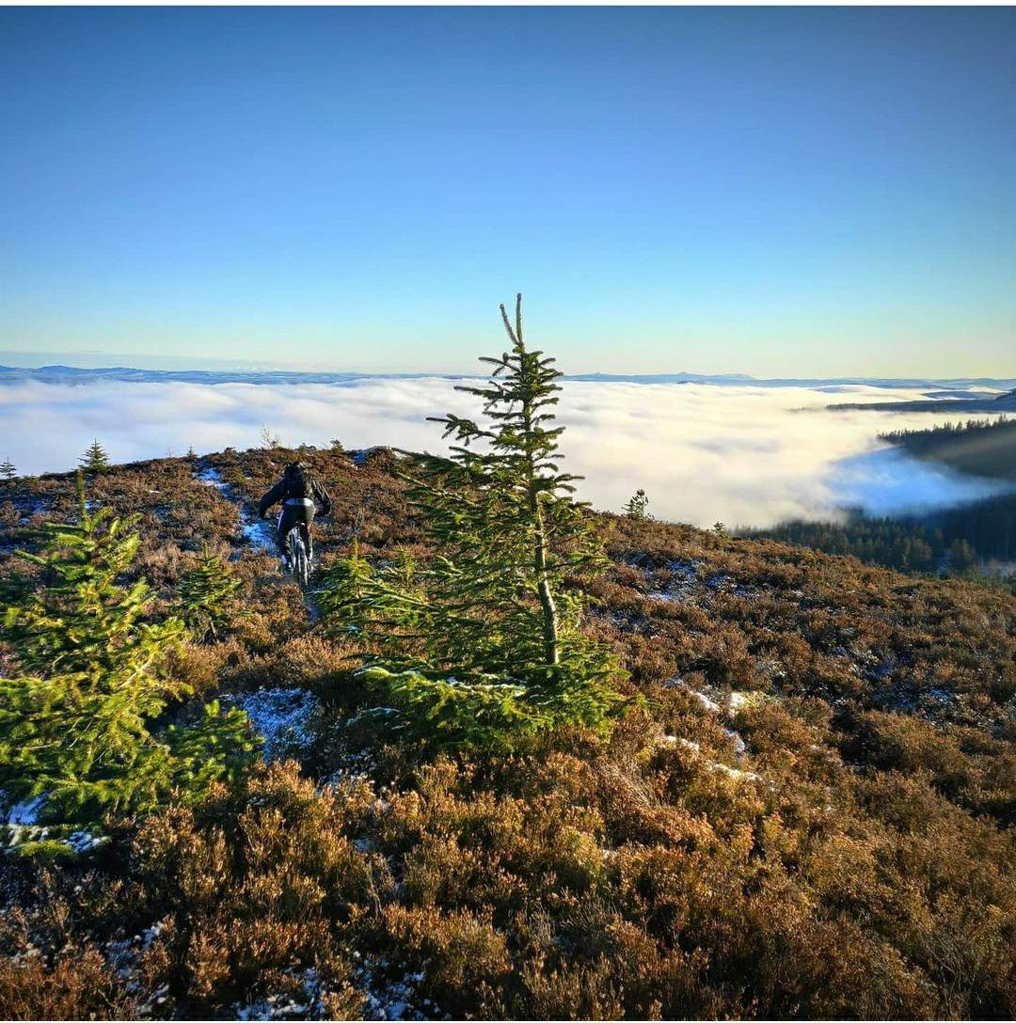
Progression Bikes
Adam Flint

Slide 2
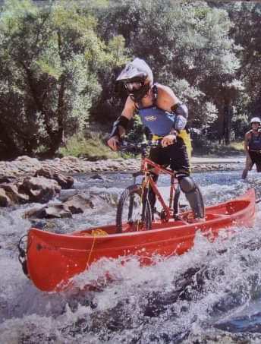
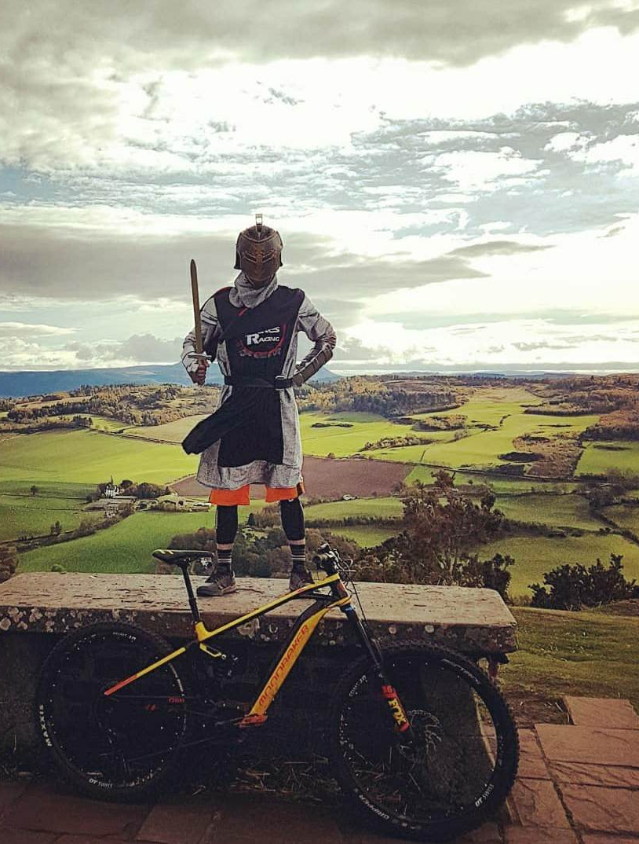
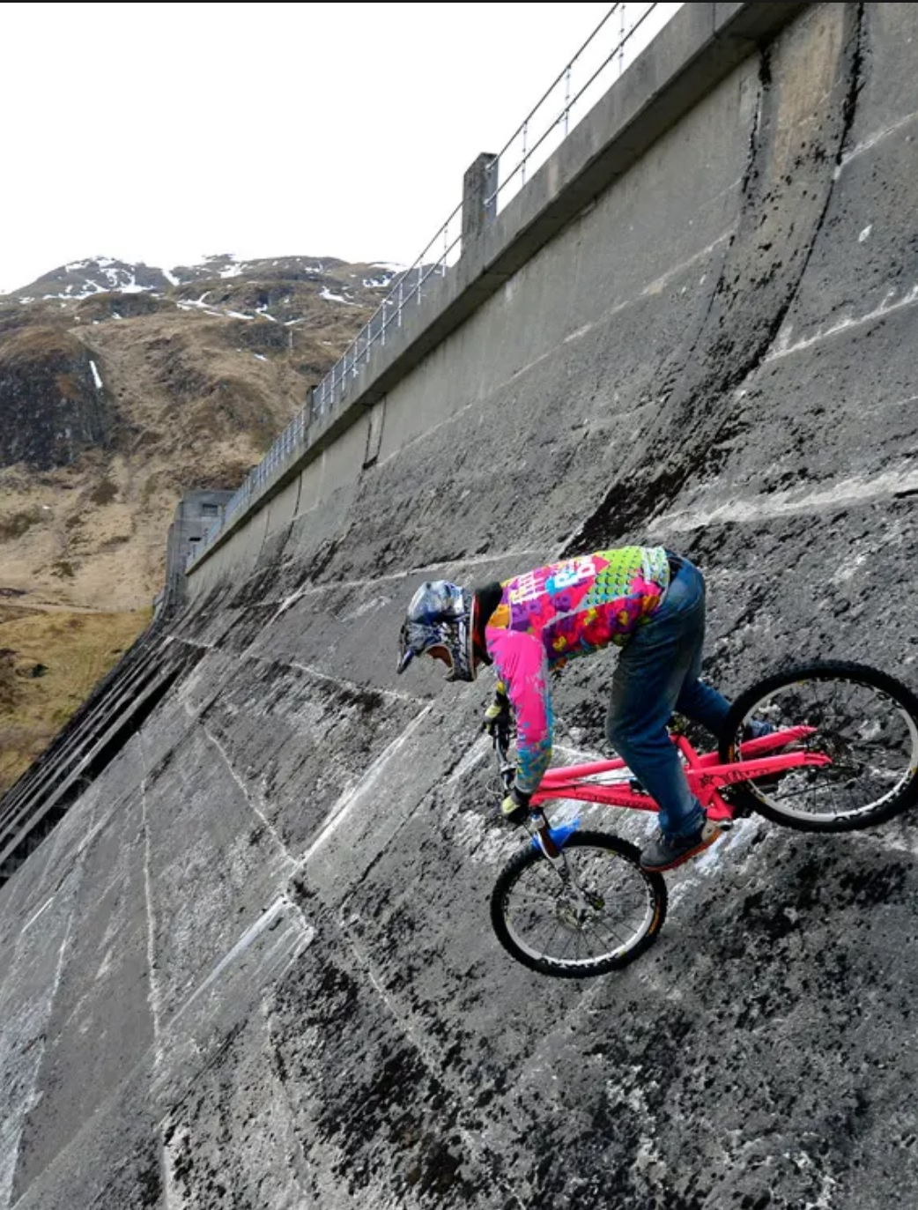
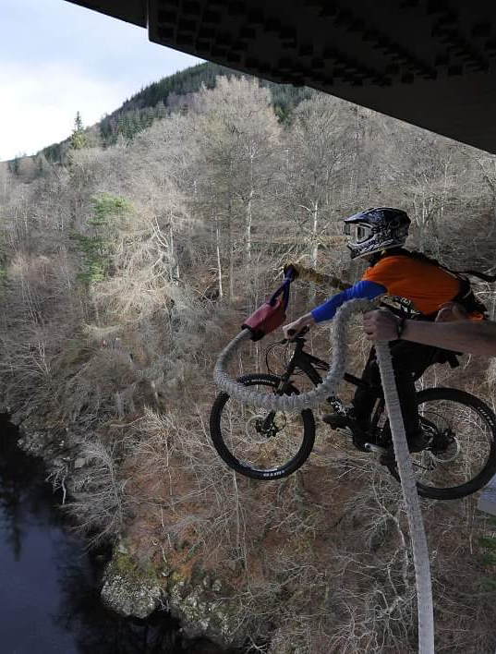
A little about me…

Slide 3
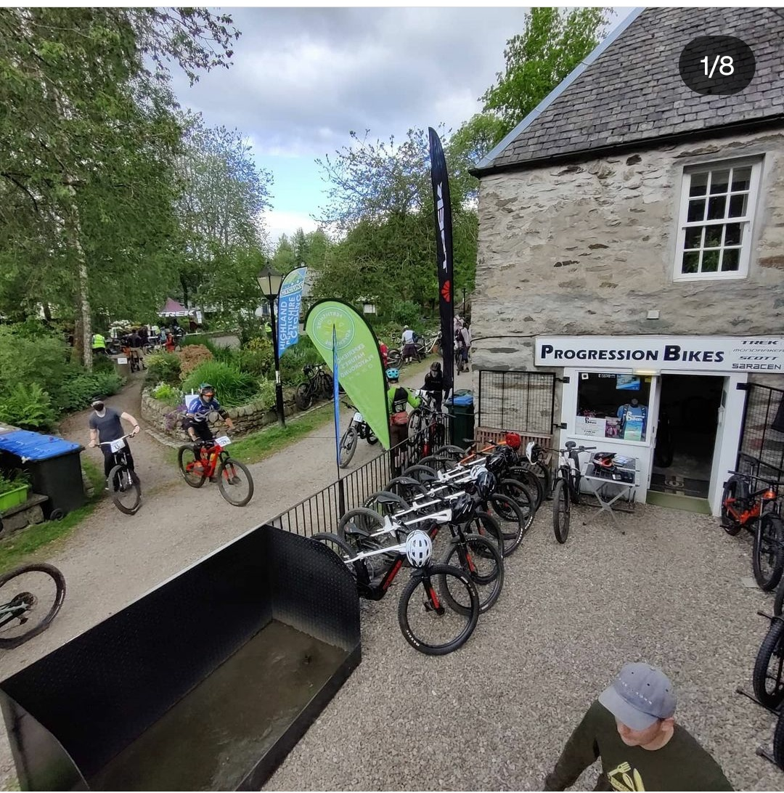
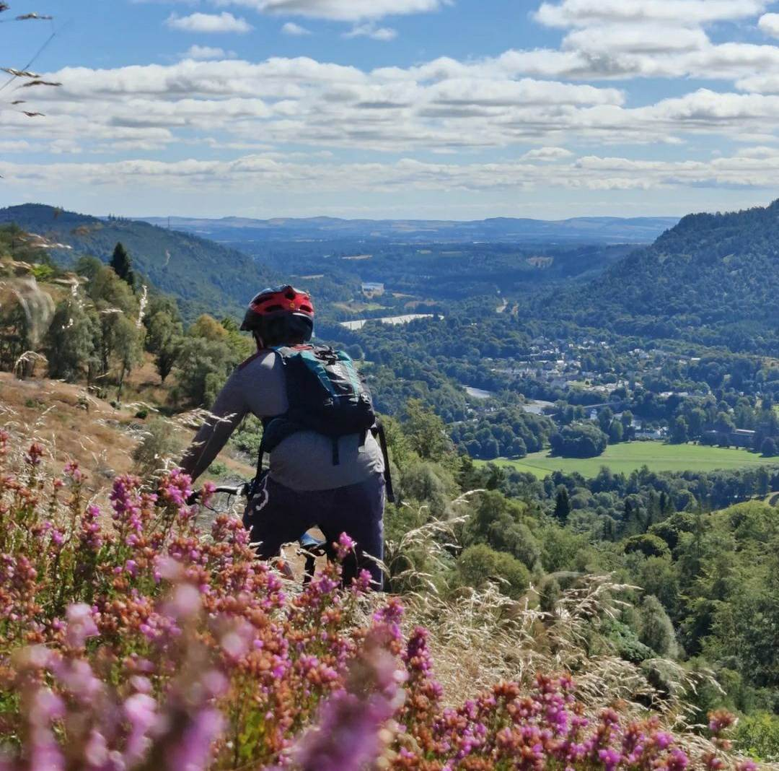
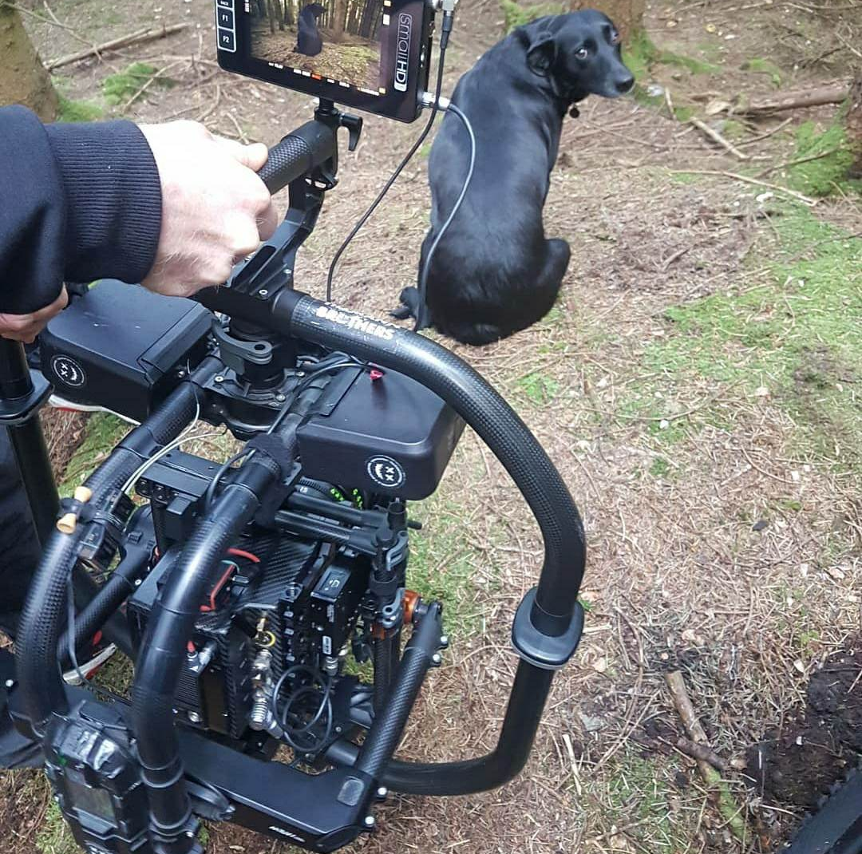
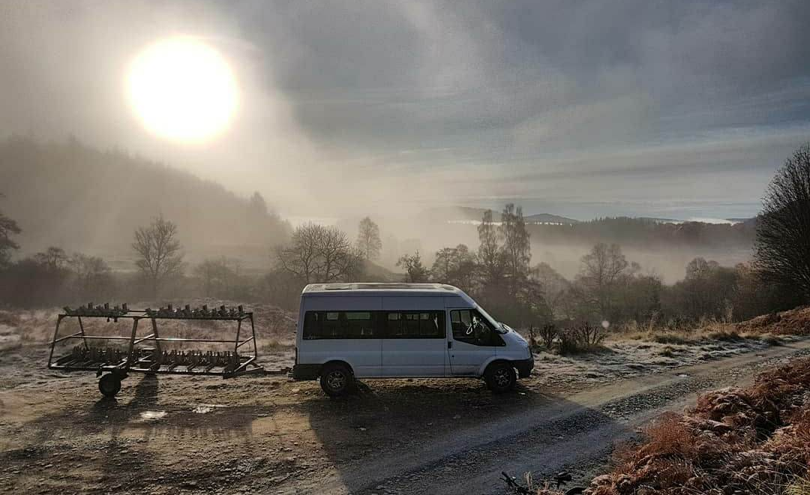
Progression Bikes

Slide 4
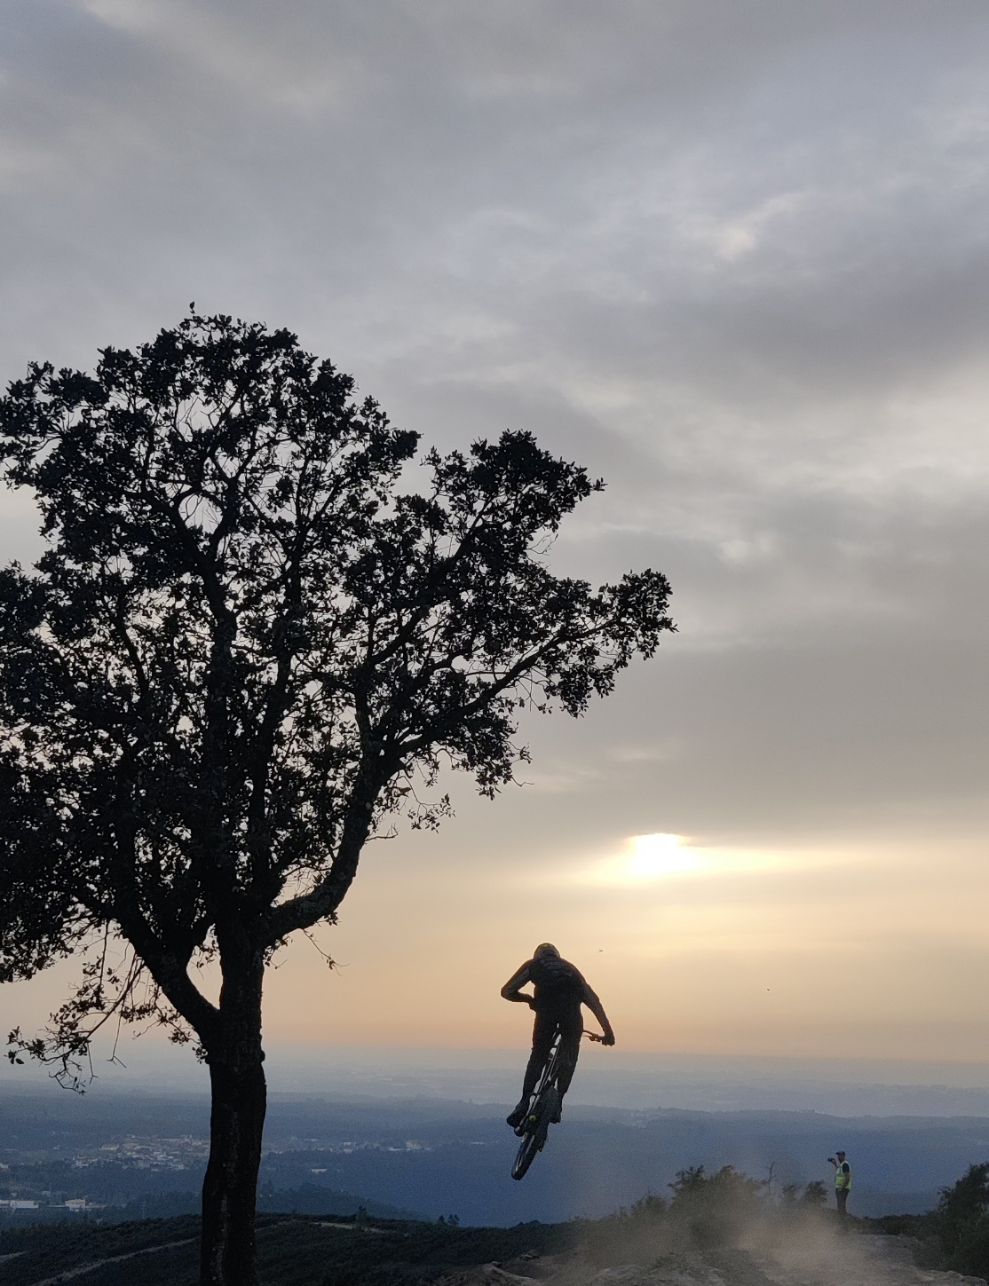
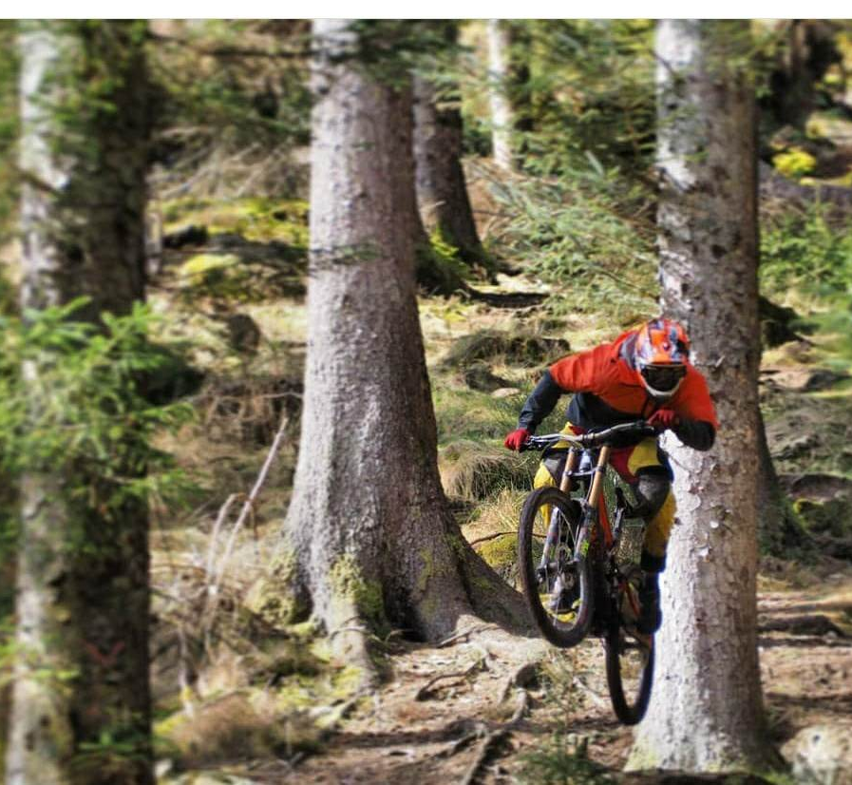
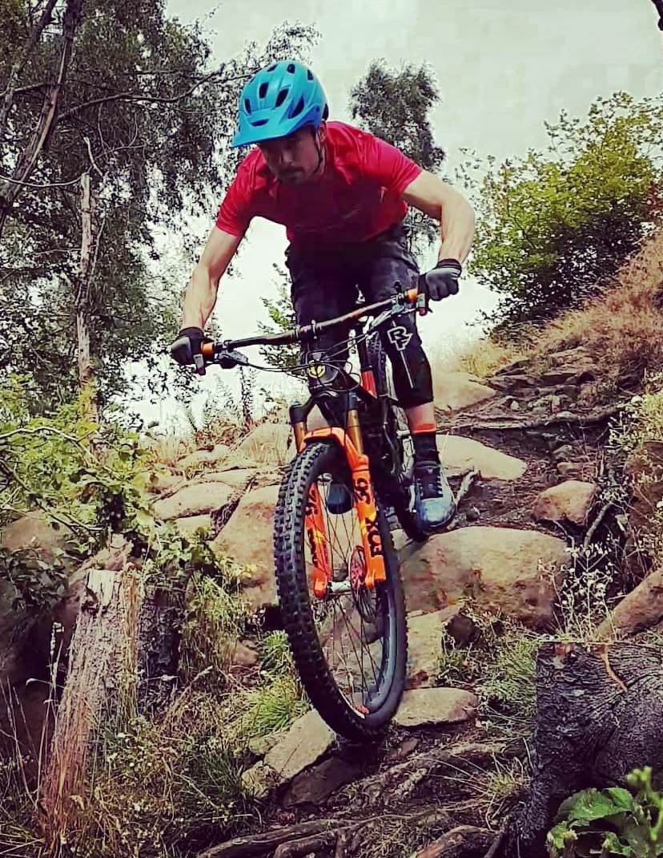
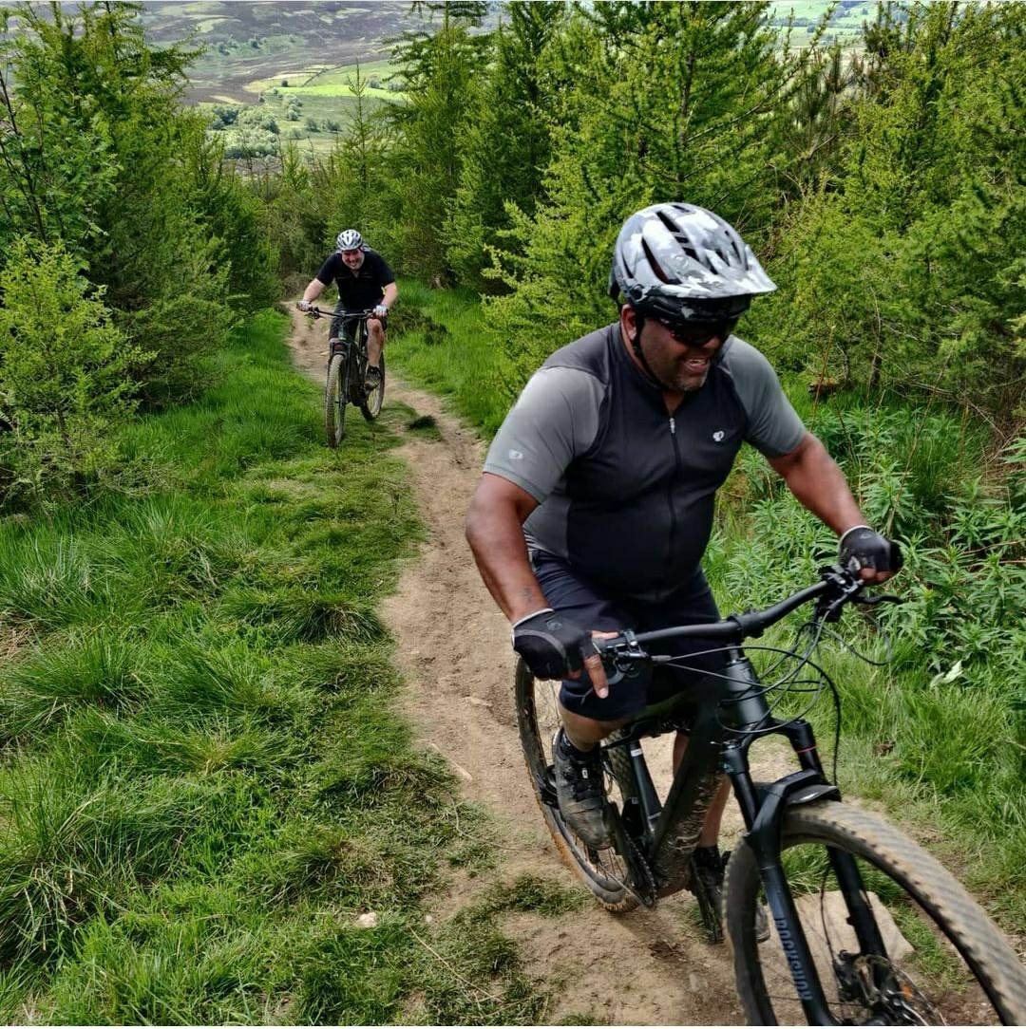
Your VIP… It’s not these guys

Slide 5
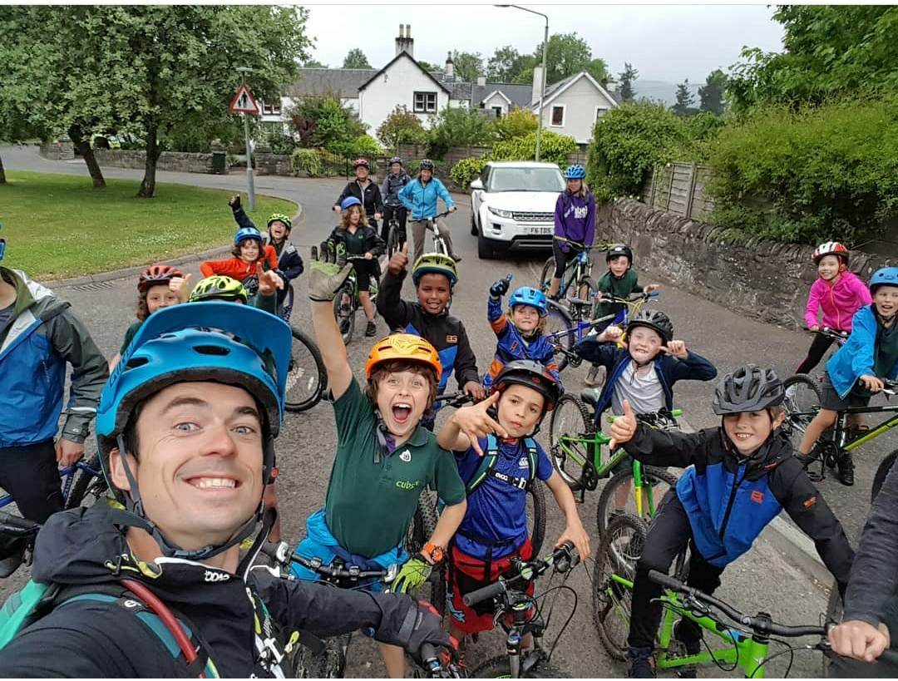
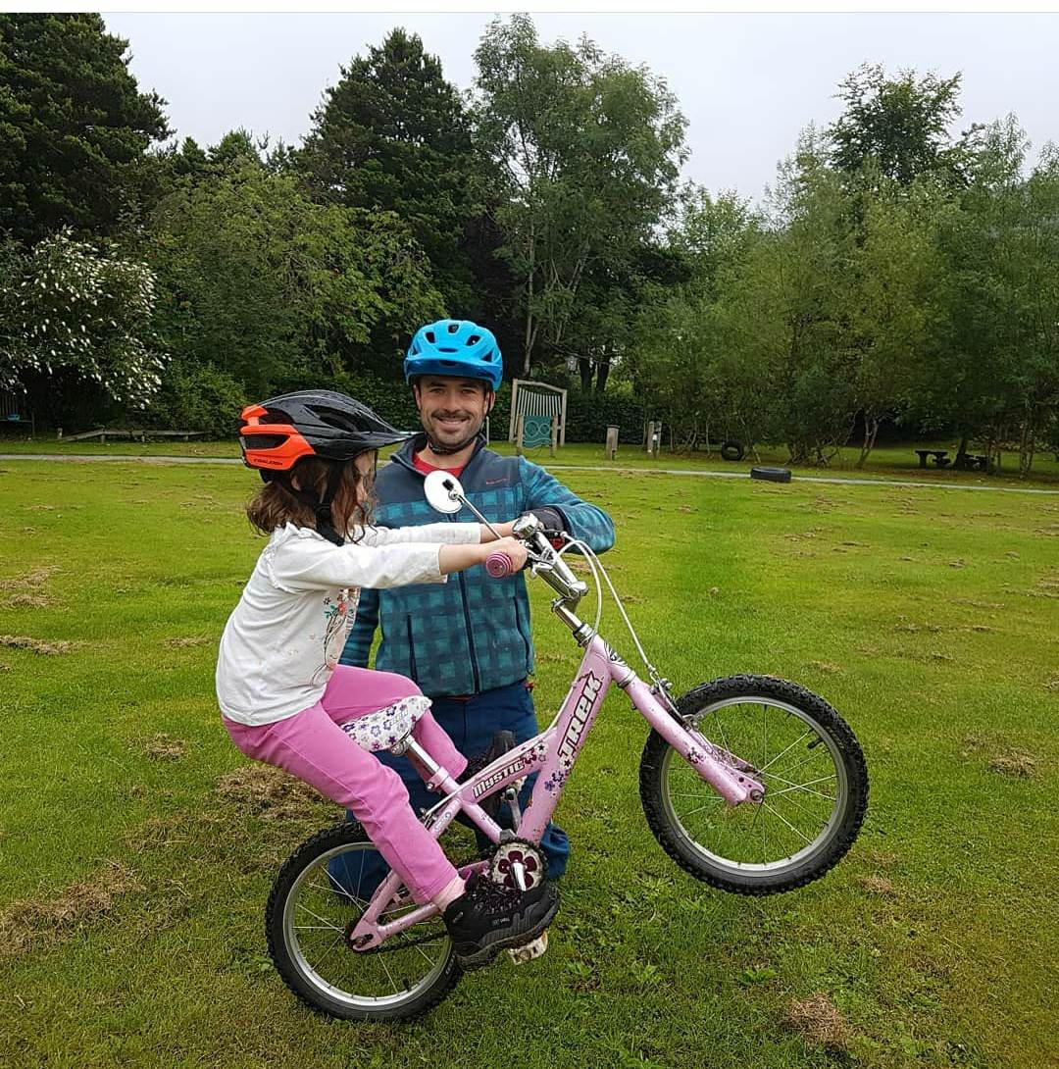
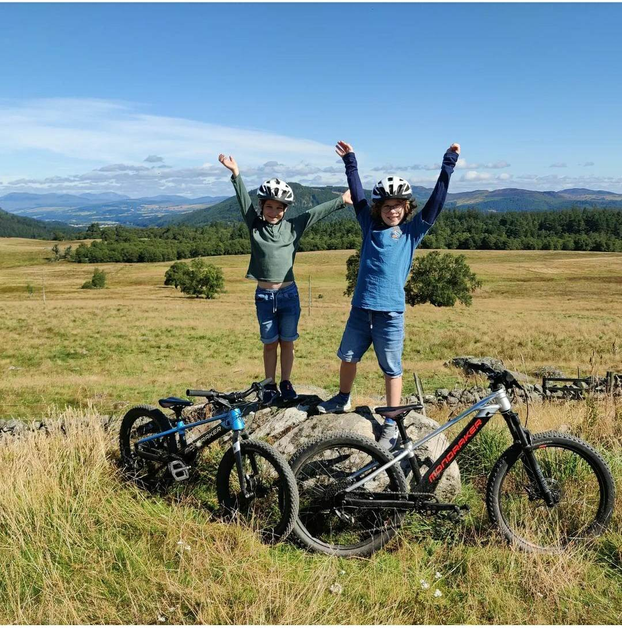
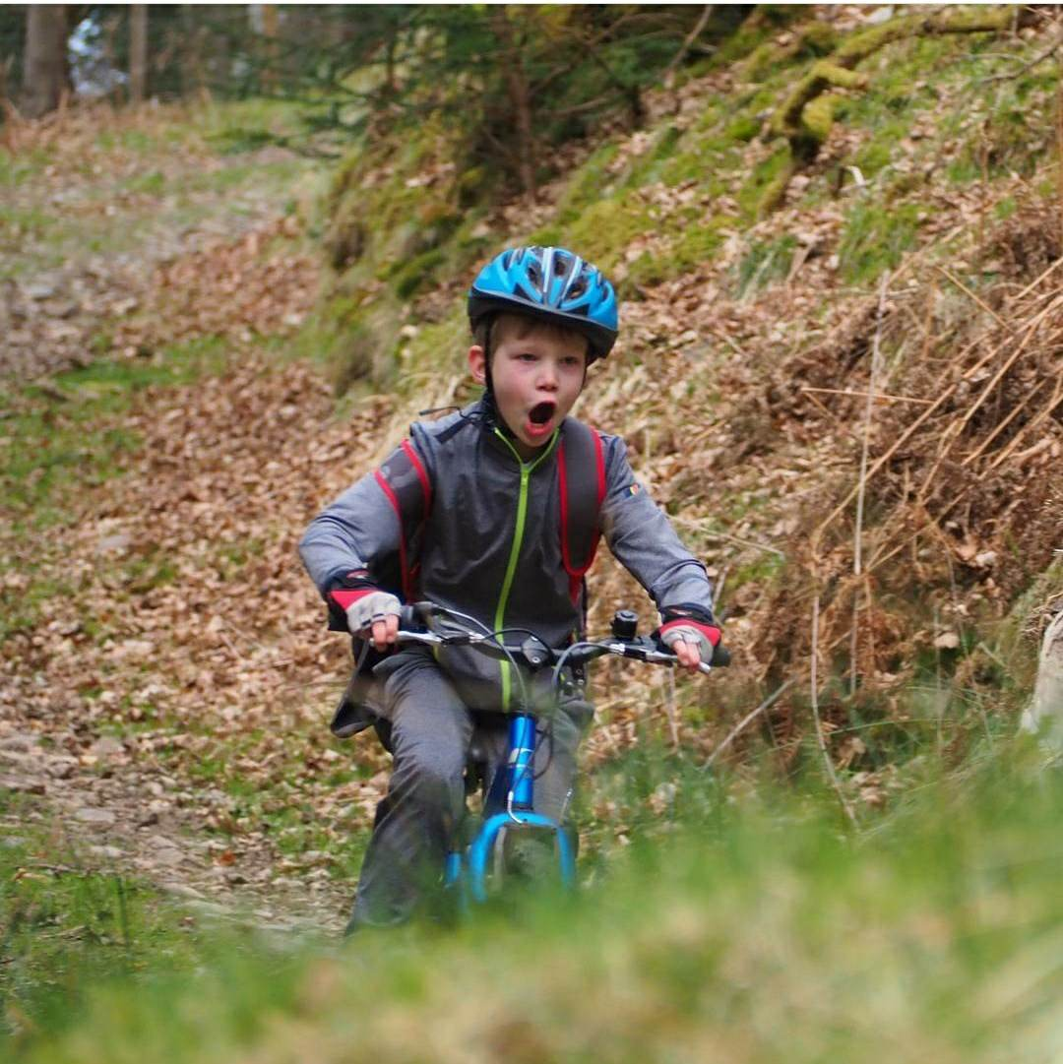
It’s the little ones

Slide 6
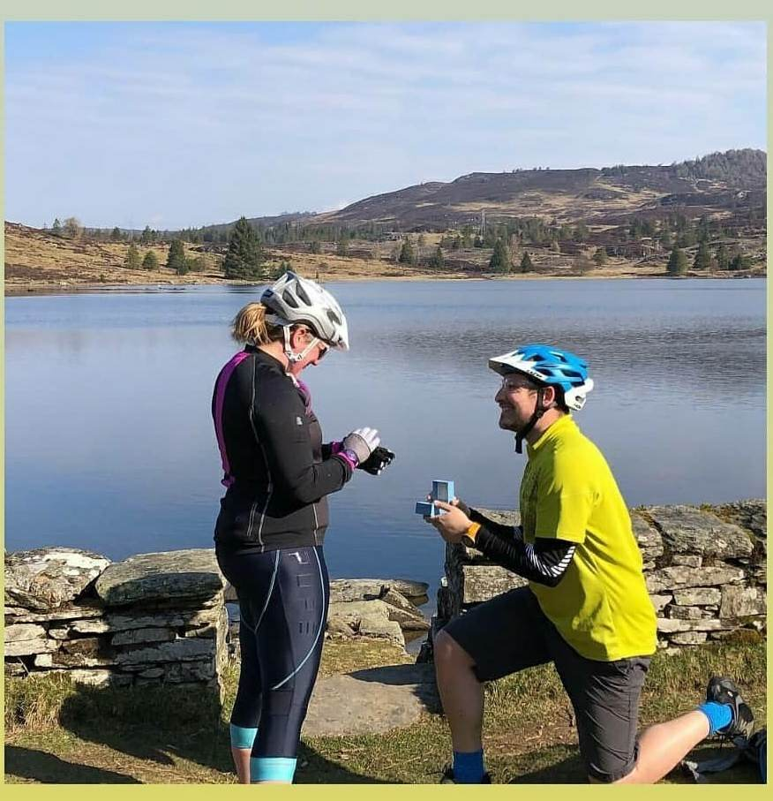
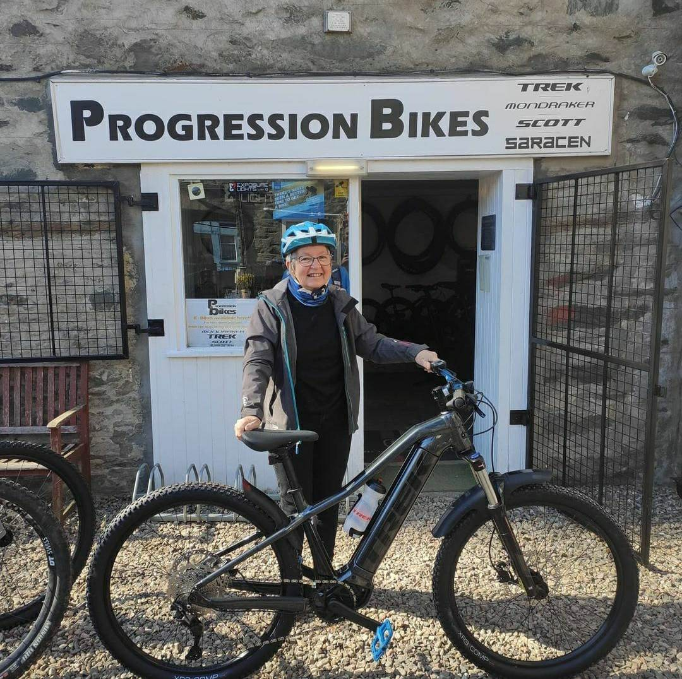
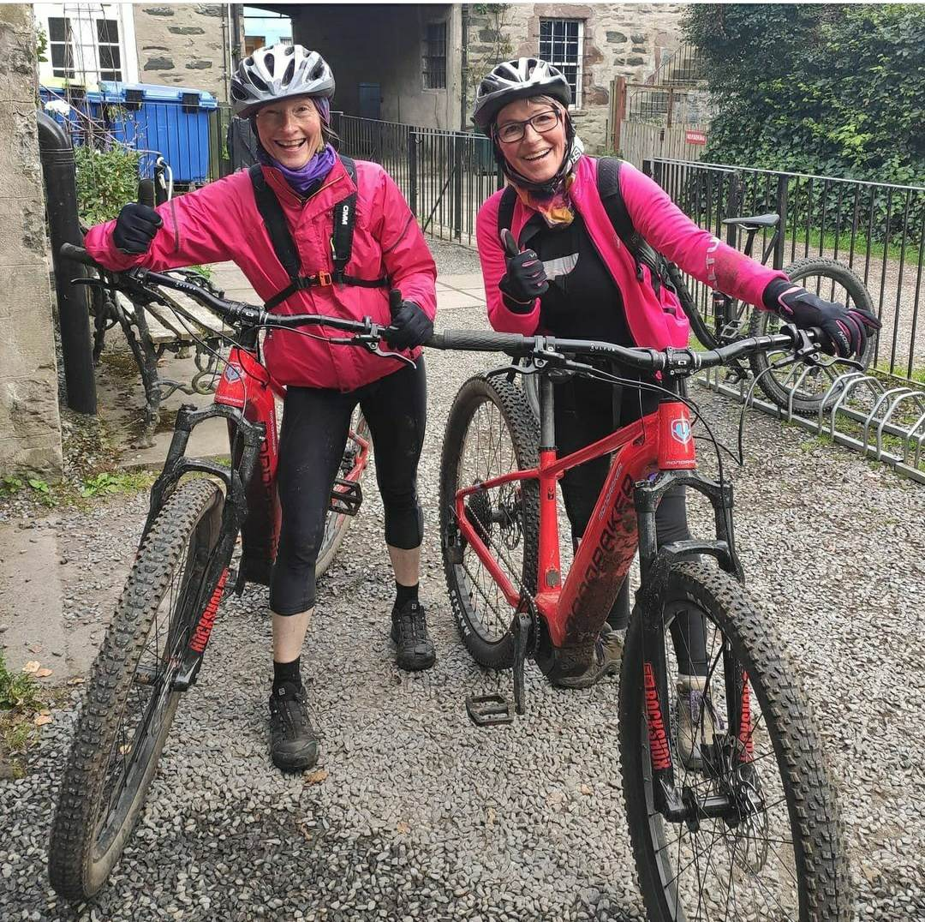
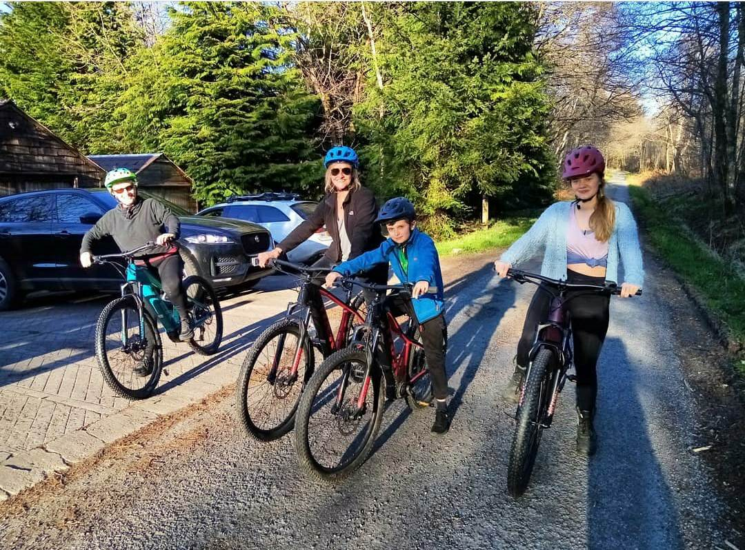
Because if they are happy, then everyone is happy

Slide 7

“Our aim is for a maximum of 15 people with 3 guides please. Electric bikes for all participants. Rough format is for guests to travel to Scotland on the Friday with dinner in the evening. We like the concept of Ballintaggart Farm and linking with a chef/cooking session, and staying at Persie House. On the Saturday, activities followed by evening dinner. Sunday will see the guests travelling back south.” London
“It was so nice to meet with you last week! I had a chance to meet with Victoria at Dewar’s and we managed to find a time-slot which would give us time for a longer tour with picnic option. Perhaps I will choose to take the opportunity to go by Queens View on our way to Aberfeldy. I definitely prefer Balnakeilly - THANK YOU ADAM for connecting me to George Goldsmith! =) However – if client chooses to stay at the accommodation in Alyth I think we would like to limit transportations and have the bike/hike in Dunkeld” Sweden
“If we choose Dunkeld as the starting point, or Ben and George at the Bunkhouse in Logierait, I think we will have a private tasting with Will from Wee Whisky Box who will come to our accommodation after the bike/hike. (Thanks Adam for the introduction with Will!)” America
“… No problem, I have a great option where we can leave our van with a fridge / freezer so if the weather is good we can set some drinks and even ice creams in it. Sadly it doesn't look like we can squeeze a whisky tasting in, although I often pop a bottle in the guide bag for a 'wee nip' for everyone at Pine Cone Point and the Loch Ordie Viewpoint. This would mean a lunch back in Dunkeld, and we will get this arranged prior to departure. We can arrange toasties and coffees to for this. It also allows for any changes in weather too. Adam”

Slide 8
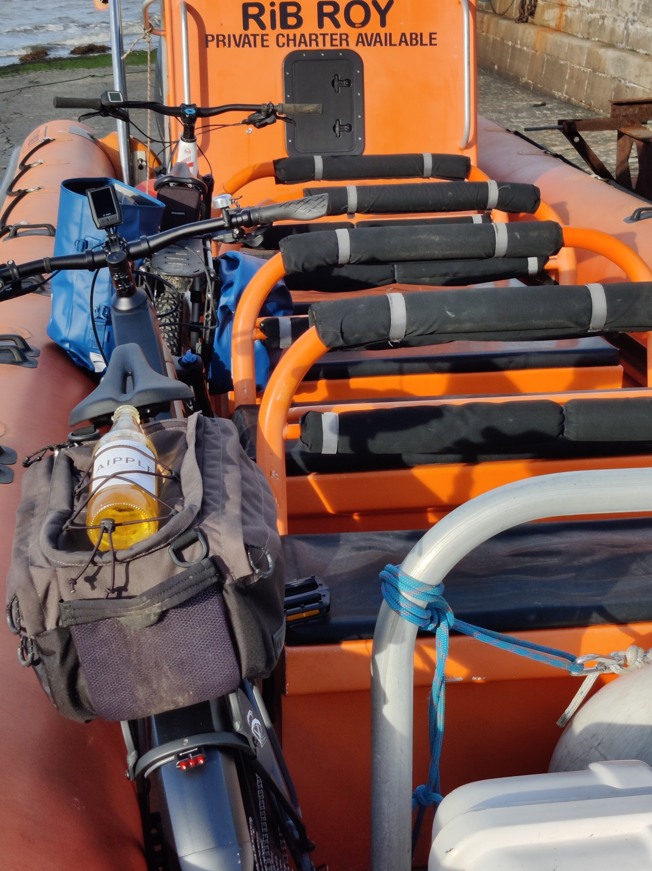
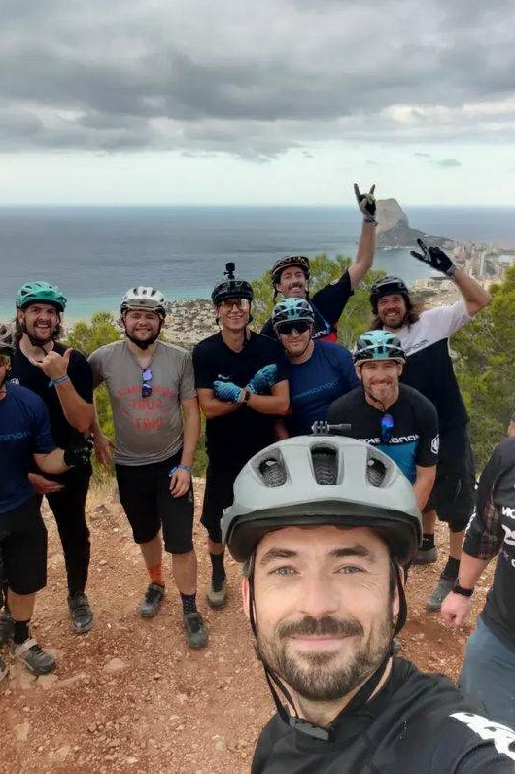
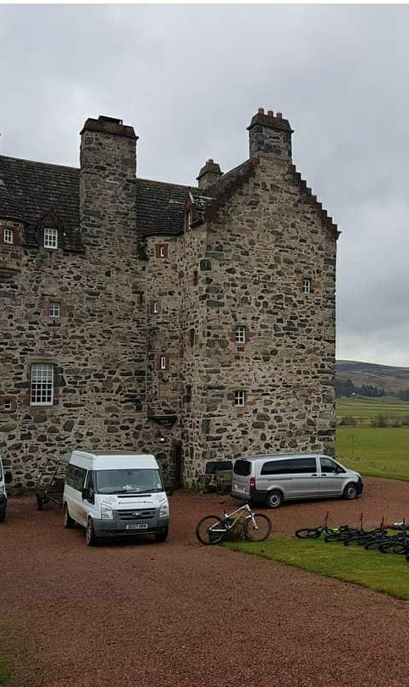
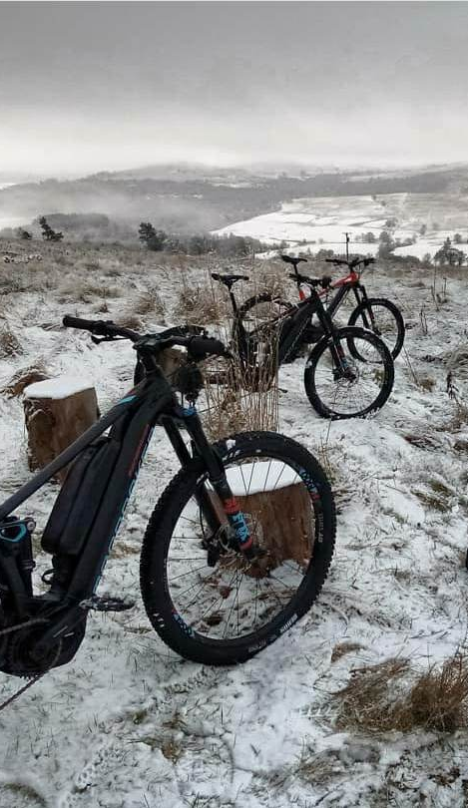
Bespoke Guided Trips

Slide 9
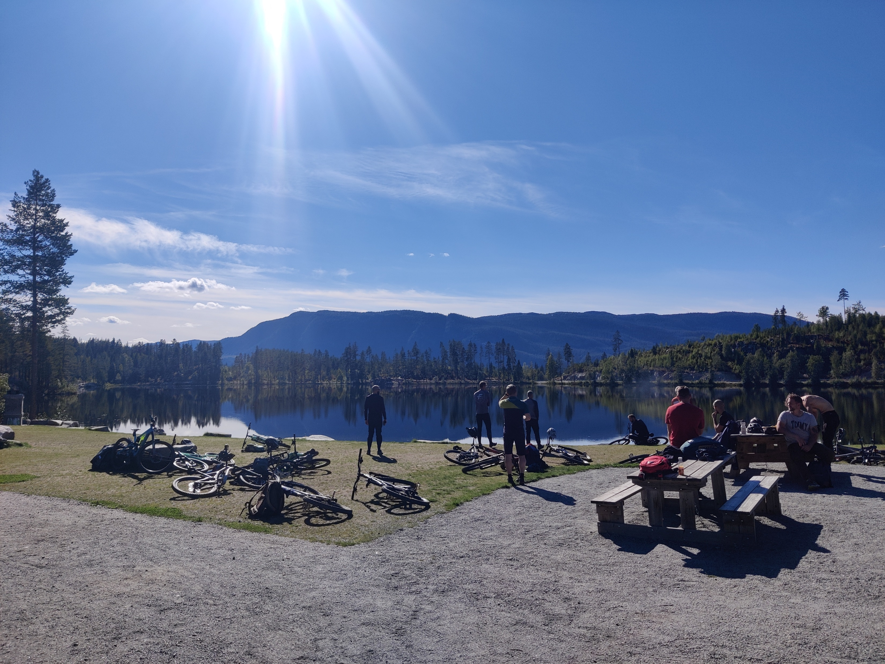
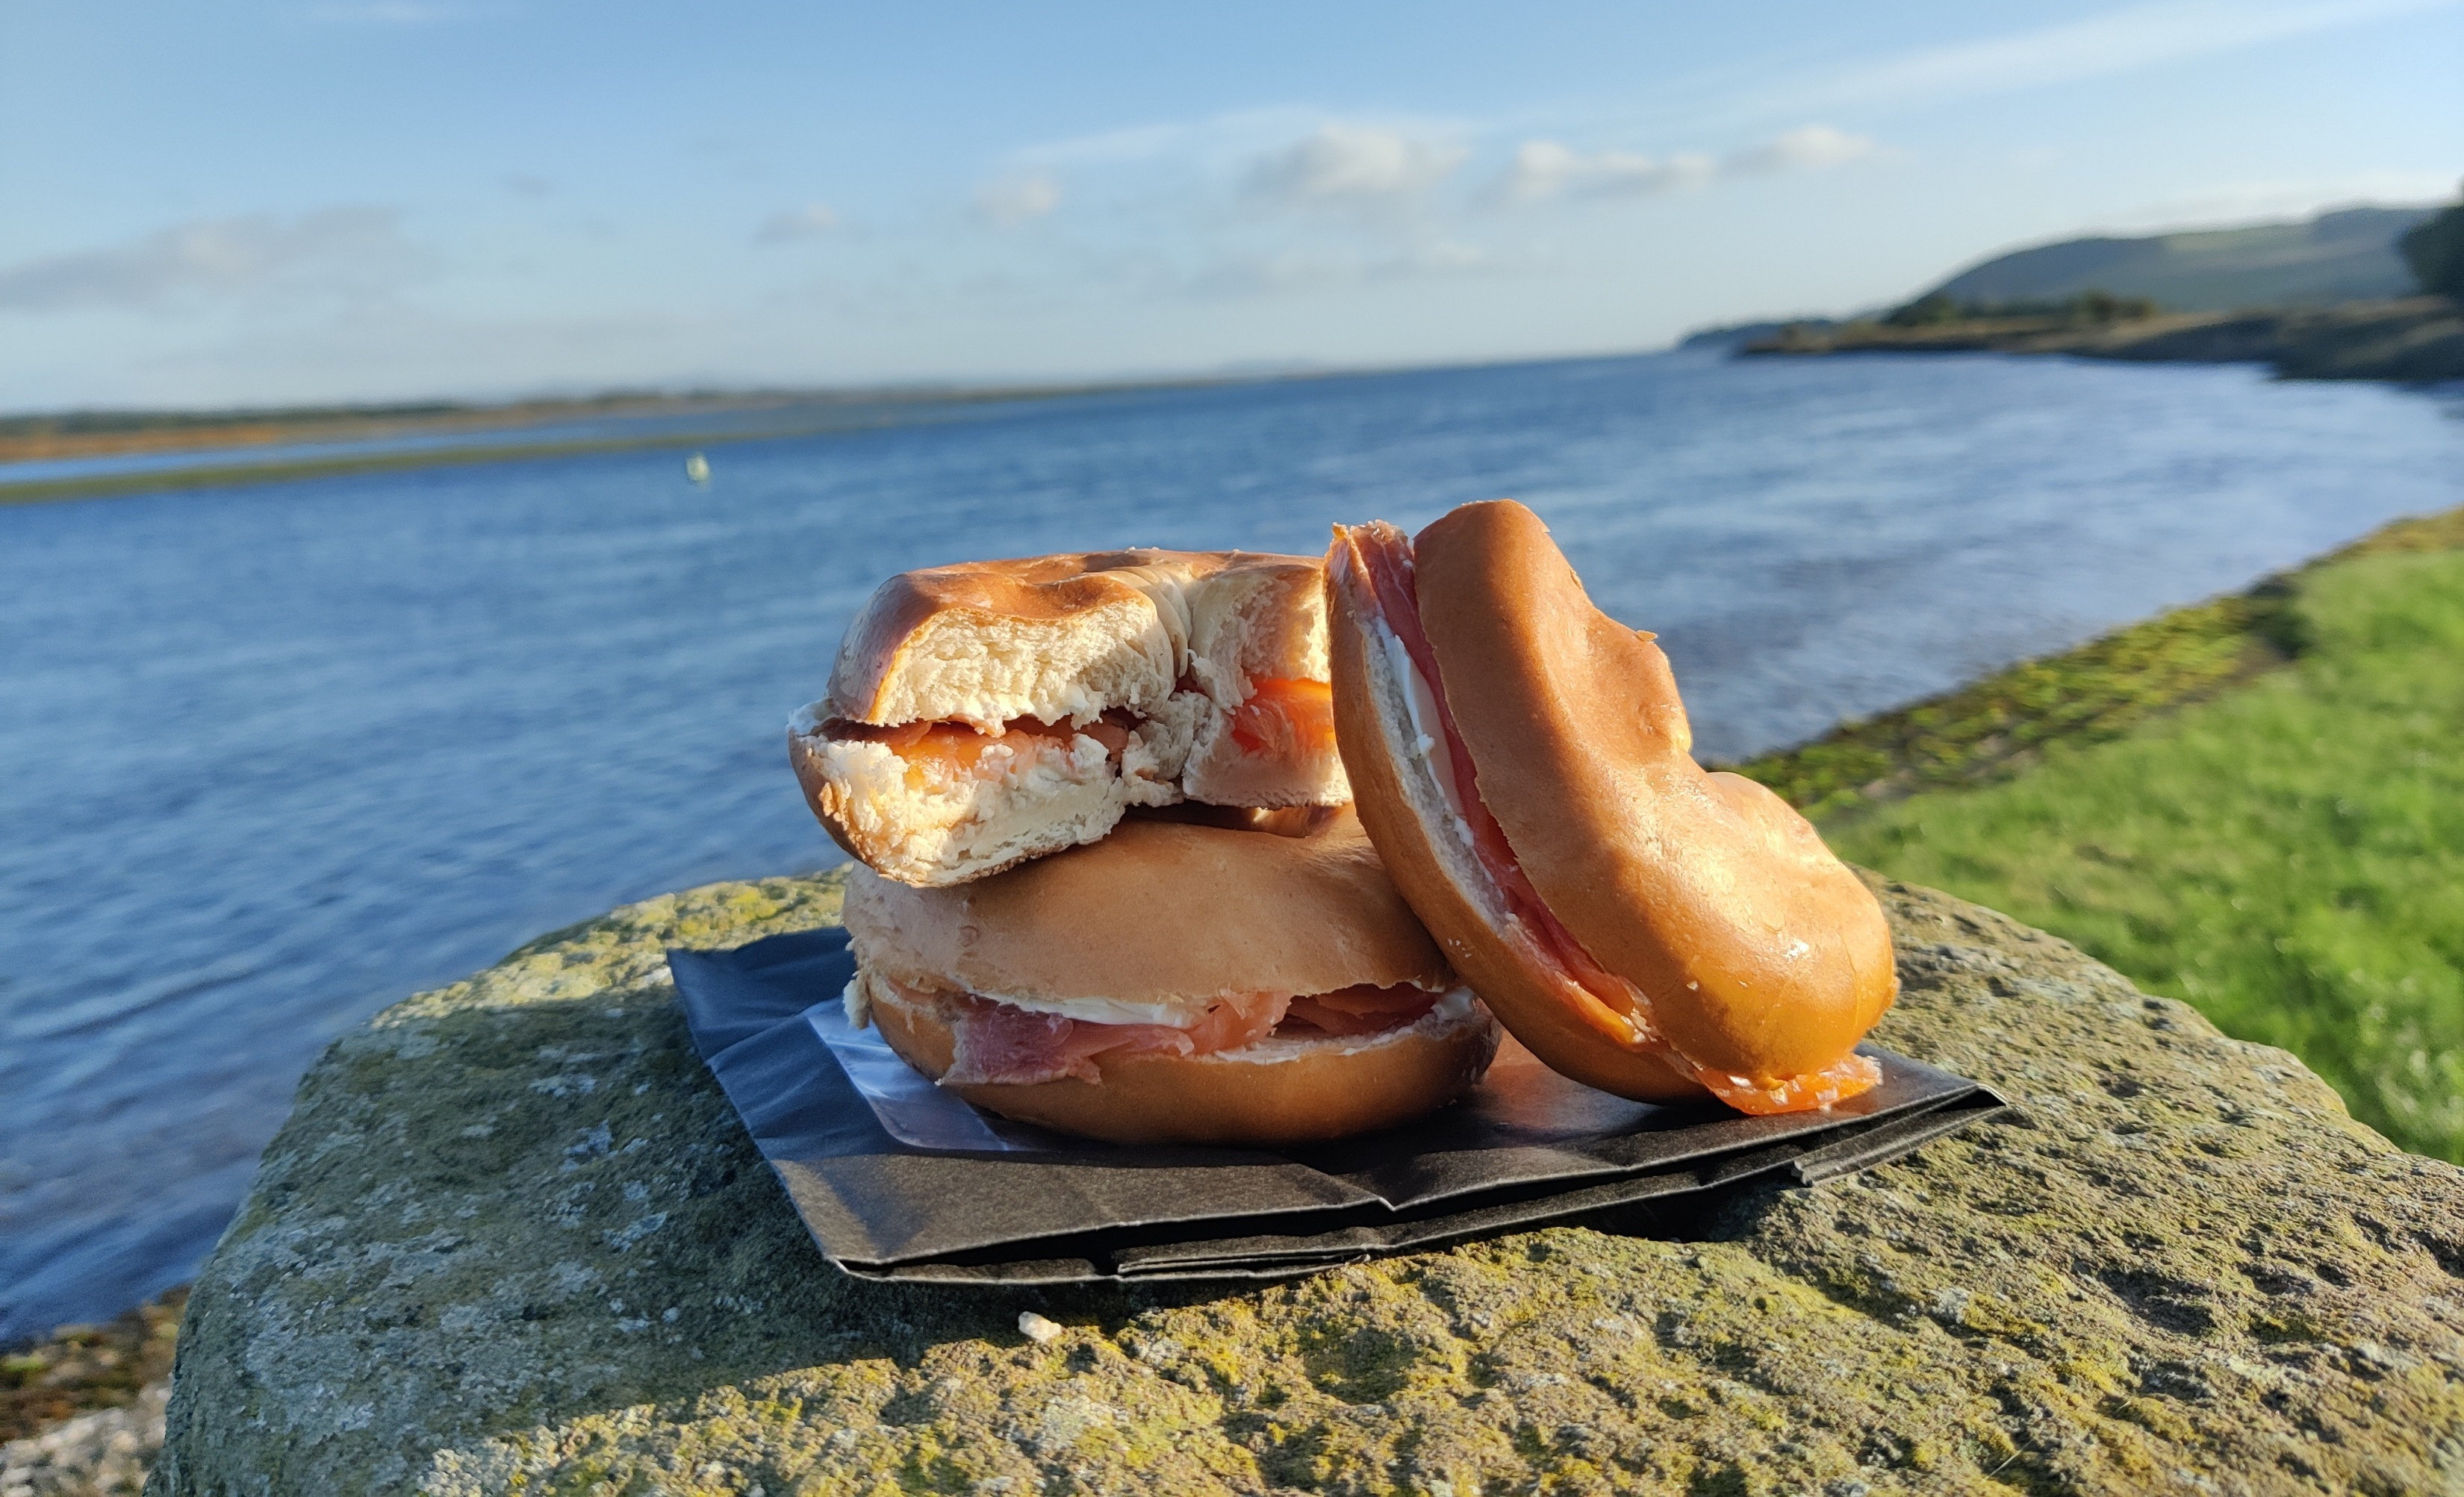
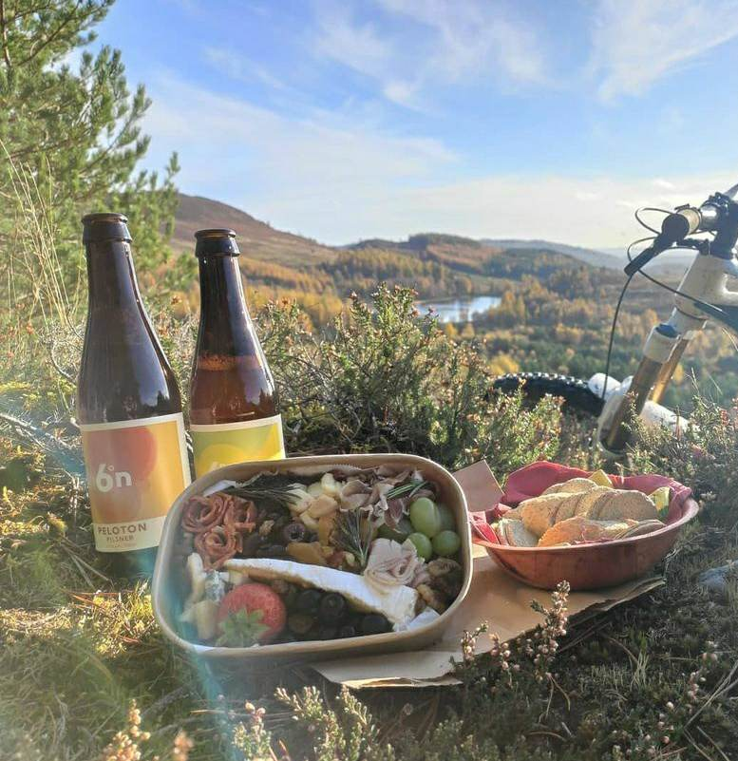
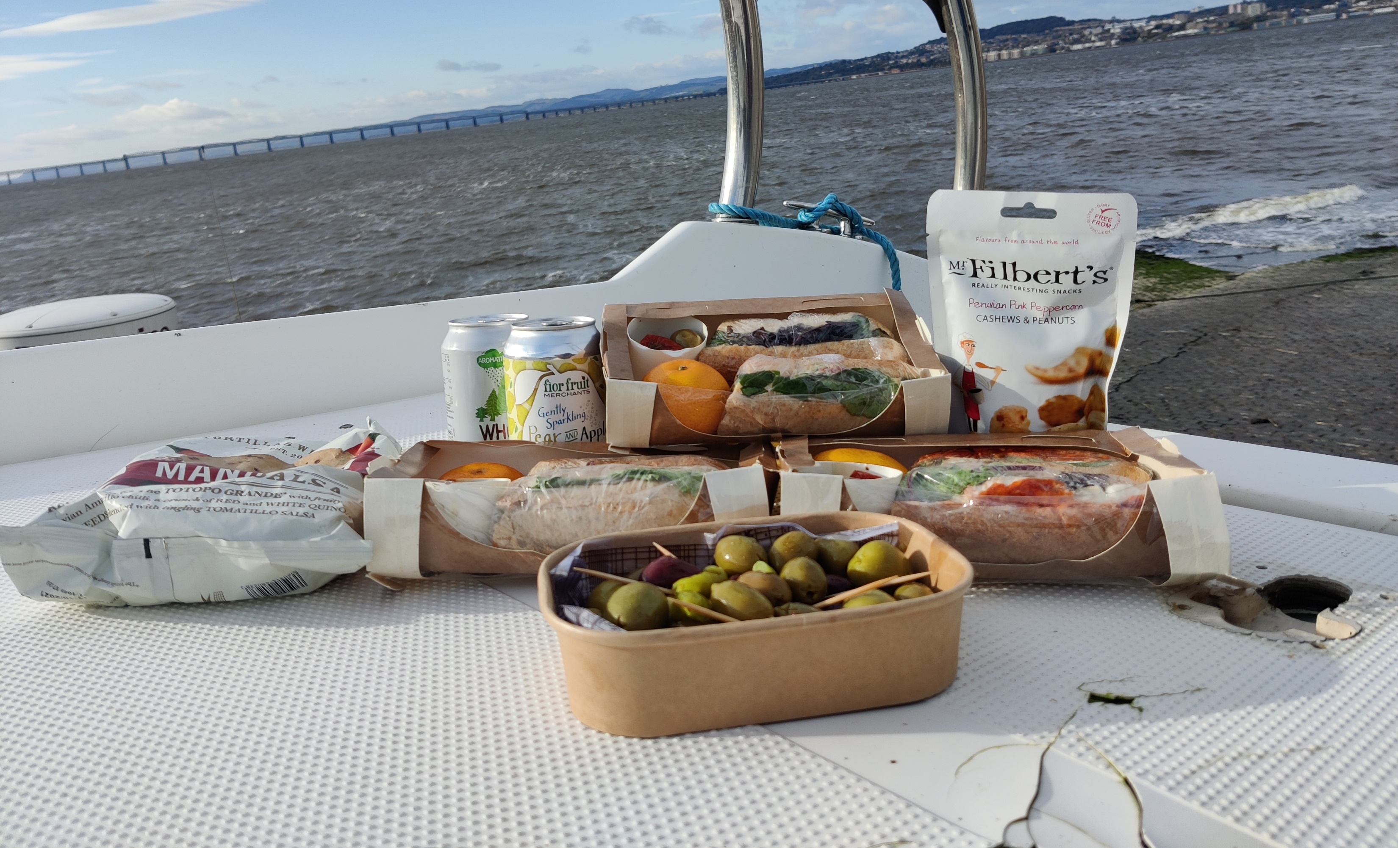
Working with flexible companies, that share your passion

Slide 10
Who do I know and trust, to deliver the same exceptional standard of experience as me?

Slide 11
Headspace and the 3 wins
- Quick and Easy –
- Rainy Day -
- Big Picture -

Slide 12
Headspace and the 3 wins
- Quick and Easy –
(Phonecall/Email, Order stock, Social Media Post)
- Rainy Day –
(Or Evening/off season, Low Impact, tidying physically and mentally, creative)
- Big Picture –
(P2P conversations, peak season planning, long term projects)

Slide 13
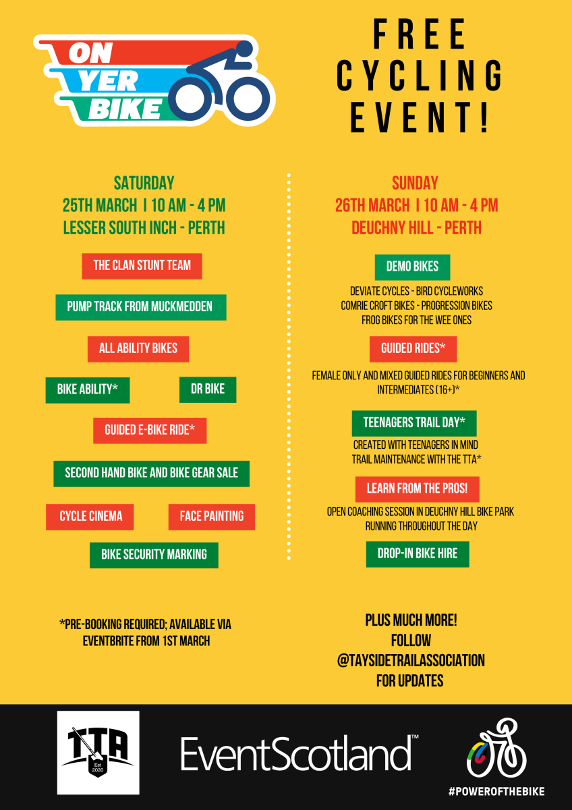



Tayside Trails Association

Slide 14
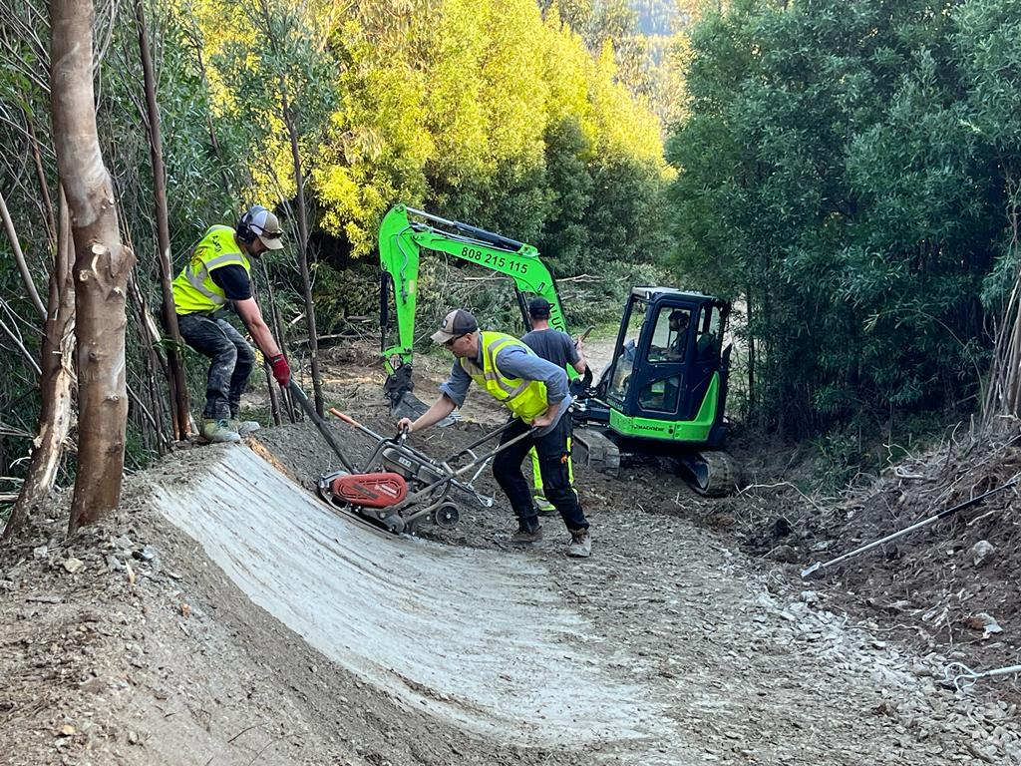
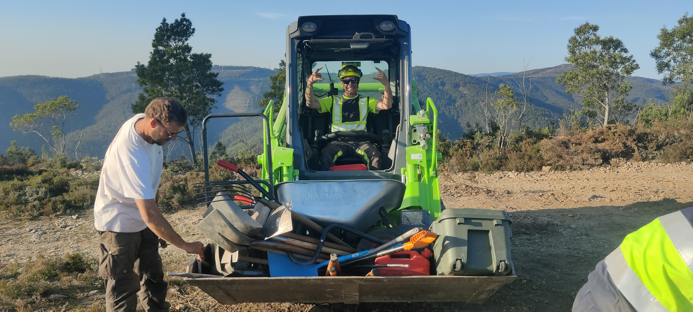
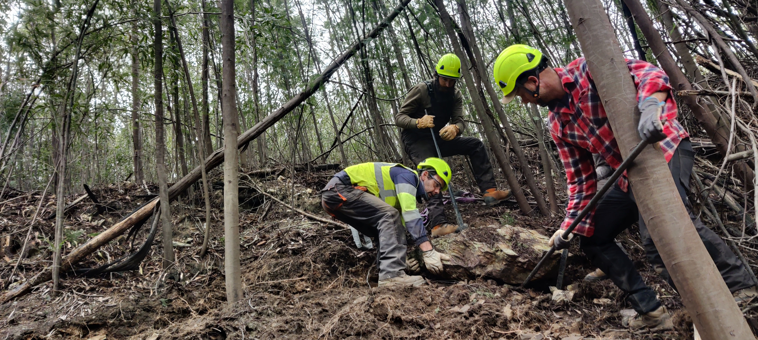
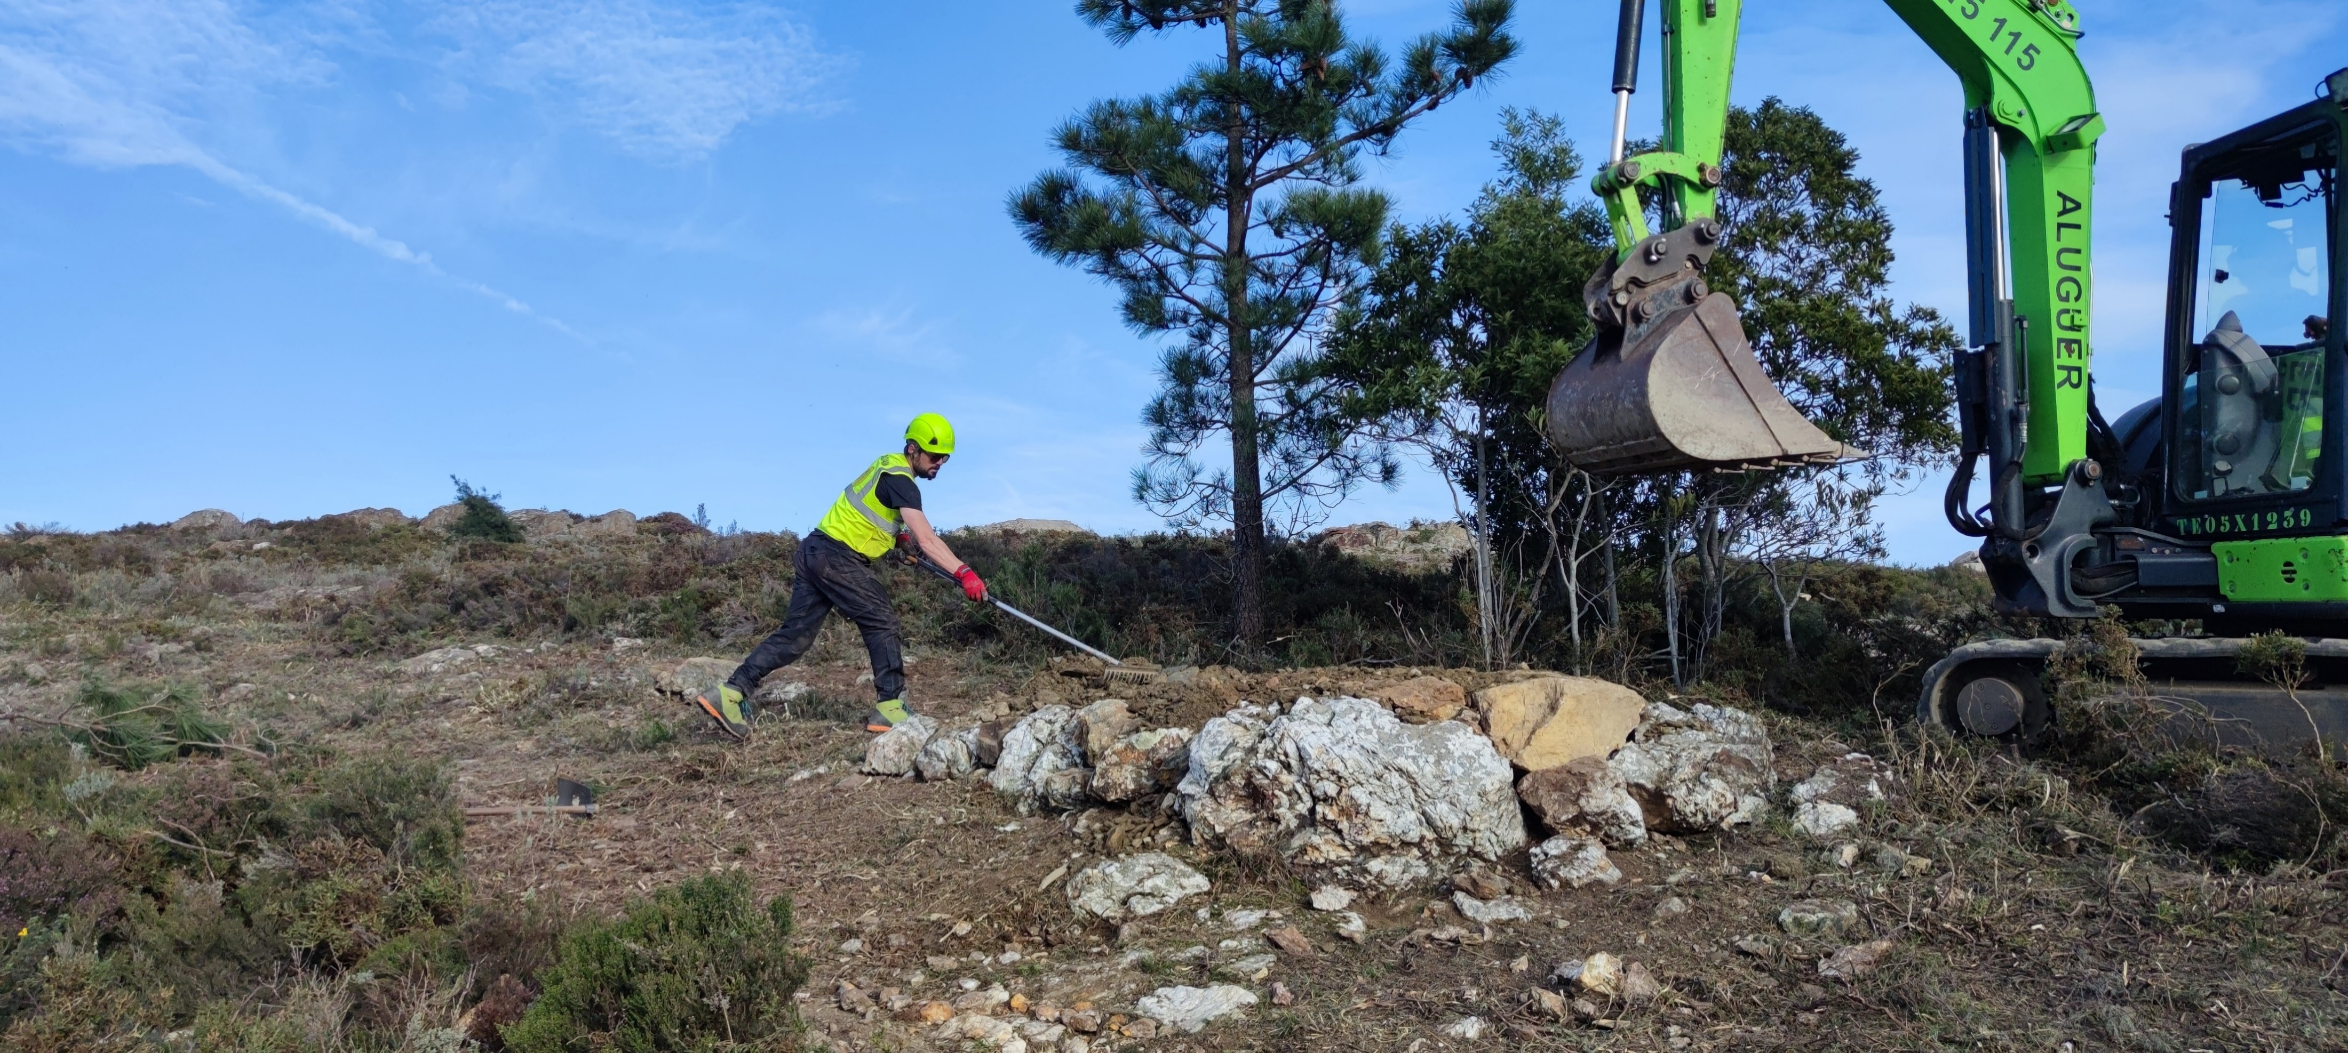
Building New Trails…

Slide 15
Thanks.
Any Questions?

